Slide 1

KUVA
The Affirmation App
(Group No – 14)
swot
feature-I
feature-II
application
about
technologies
Akshit Jayant Chheda – 1891004
Ronik Mehul Dedhia – 1891007
Tanuj Rajendra Joshi - 1891014
Guide - Mrs Neeta Kadukar

Slide 2

swot
feature-I
application
feature-II
about
technologies
Kuva = Lotus
Symbol of purity, enlightenment, self-regeneration and rebirth.
App has powerful effects to minimize anxiety, stress, and defensiveness associated with threats to our sense of self while keeping us open to the idea that there is room for improvement.

Slide 3



Cards
Swipe
Audio
1
3
5
Clickable
Scrollable
Speech
Display Various Categories
Vertical Swipe With PageViewController
Text To Speech
Camera
Multiselect
swot
feature-II
2
4
feature-I
application
about
technologies
Toggle
Multiple Cards
Mirror Talking
Handpicking Your Favorite Category

Slide 4
Alarm
Subscription
Admin
6
8
10
Notify
Monthly/Annual
Superuser Panel
Reminders At Selected Intervals
Choose According To Your Preference
Robust Dashboard In Laravel
AWS
Razor-Pay
7
9
feature-I
swot
about
application
feature-II
technologies
Payment Gateway
Back-End
Reliable And Consistent Storage
Wide Range Of Payment Solution

Slide 5



02
03
01
swot
feature-I
application
feature-II
about
technologies
FLUTTER
AWS
RAZOR PAY
High App Responsiveness,
Cross Platform Development.
Reliable And Consistent Service That Provides Cloud-Based On-Demand Storage.
Supports Wide Range Of Payment Solutions And Services To Support Your Versatile Business.

Slide 6









Front Line Workers
Athletes
swot
Student
application
feature-I
Patients
feature-II
about
technologies
Working Professionals
Confined People

Slide 7




swot
feature-I
application
feature-II
about
technologies
Strengths
Weakness
Opportunities
Threats

Slide 8
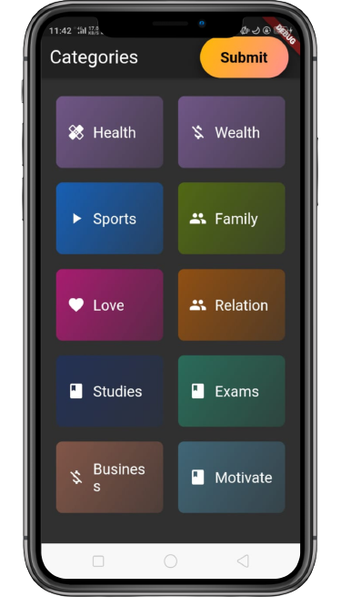
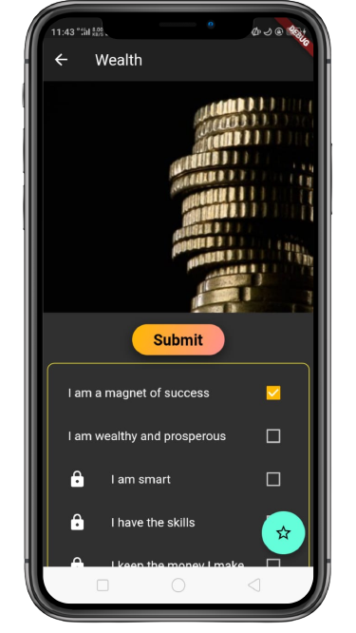
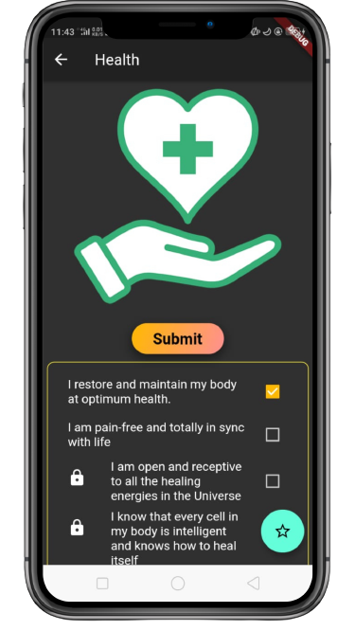

Slide 9
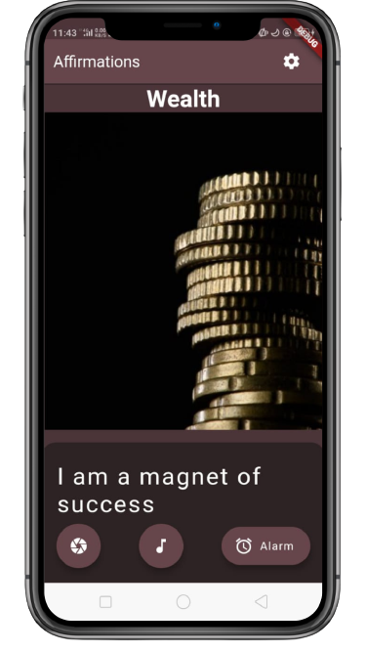
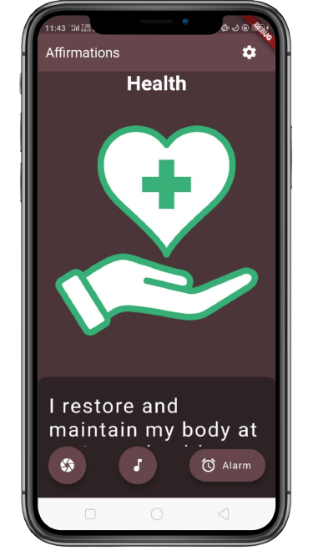
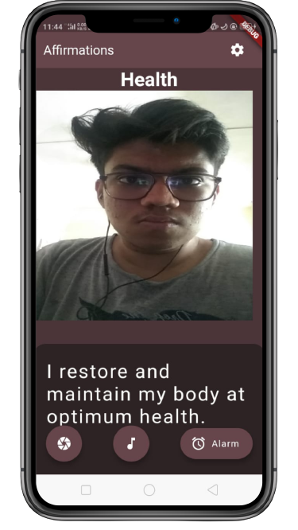

Slide 10
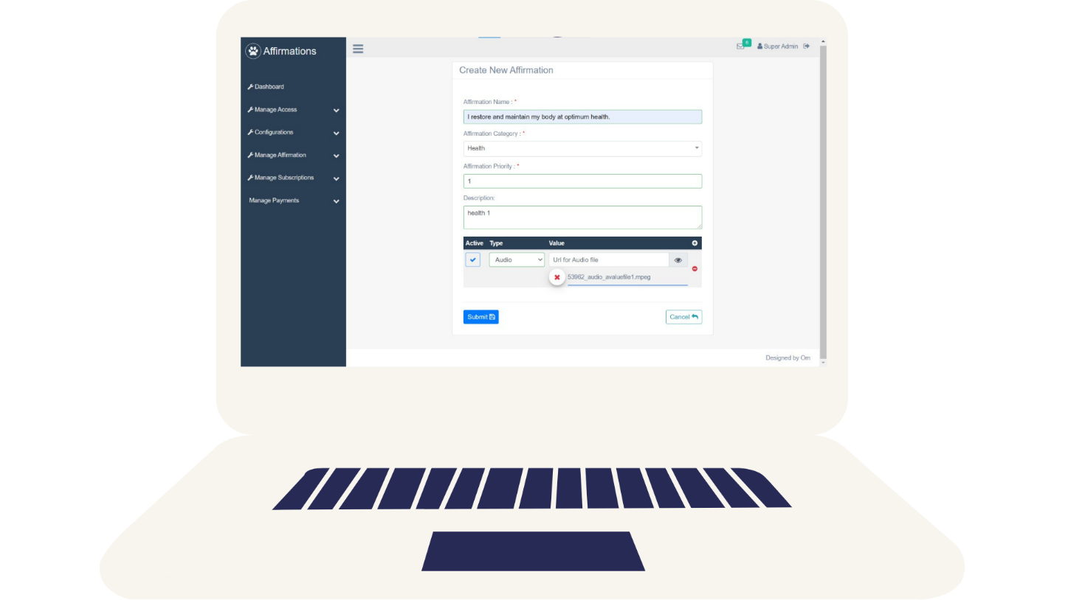
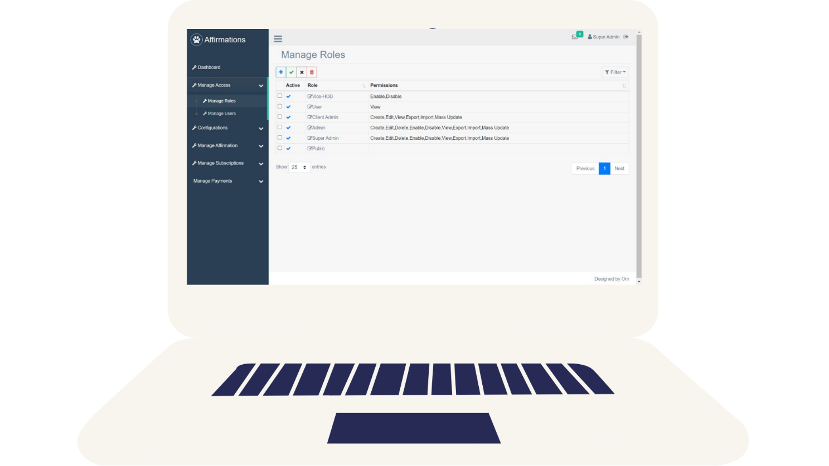

Slide 11
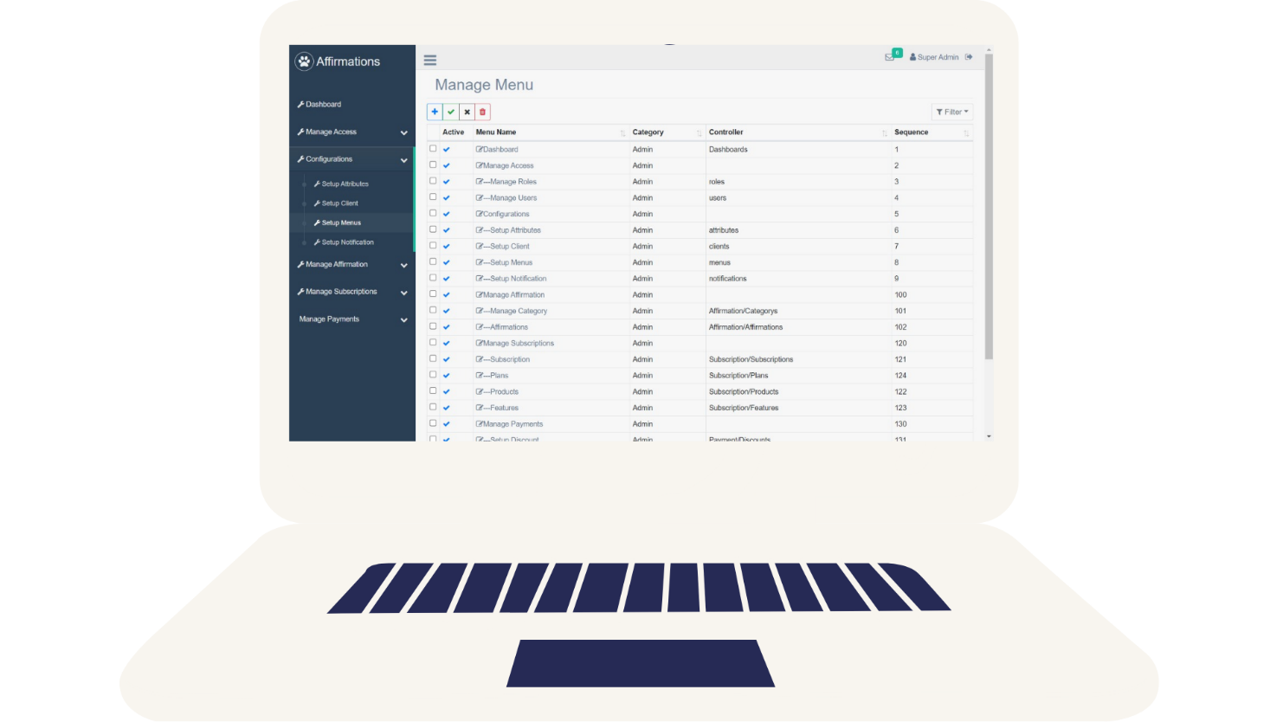
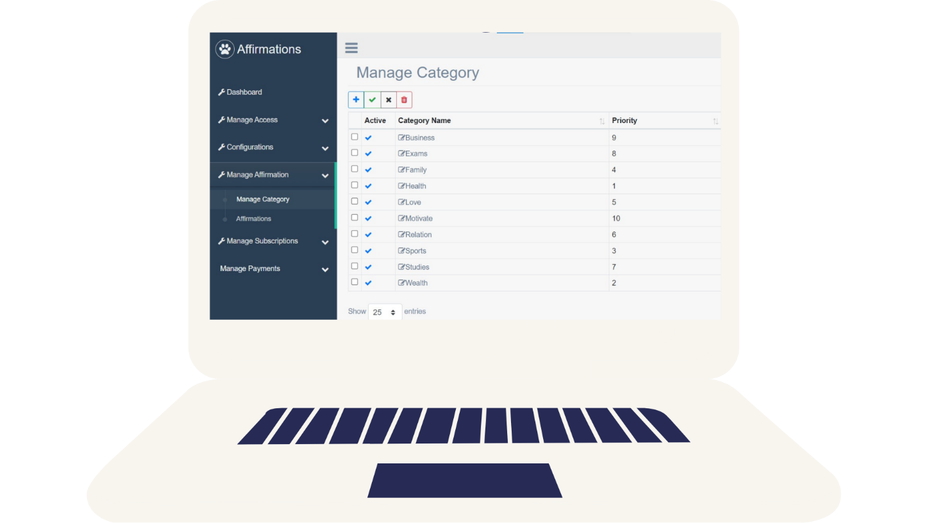

Slide 12


